Slide 1

Notes:
Welcome, everyone. Today we are exploring "The Latticework of Exceptional Capital Allocation," drawing directly from Charlie Munger’s mental model framework and Mohnish Pabrai’s insights at UNO.
Charlie Munger famously advocated for building a latticework of mental models across multiple disciplines. When you layer these mental models together at the same time, you create what Charlie called "Lollapalooza effects"—where $1 + 1$ doesn't equal $2$, but $11$ or even over $1,000$. This mental model hack gives you a massive leg up in life and investing, enabling you to achieve superior long-term results over people who may be smarter or work harder than you.
Over the course of this presentation, we will walk through key mental models that bridge classical value investing with modern compounding, focus, discipline, and execution.
https://www.youtube.com/watch?v=Yx1yAhjsDsE

Slide 2

Notes:
Let's start at the foundational level: Belief & Focus.
1. The Bedrock: Munger’s core premise is simple: Take a simple idea and take it seriously. None of the other mental models work unless you go hook, line, and sinker—100% all in—on this baseline. As Pabrai noted, when asked why people fail to implement simple ideas, the answer is usually that humans resist fanatical extremes. But to truly succeed, you must take simple, powerful truths seriously.
2. The Arjuna Focus: This model comes from ancient Indian history. When the guru Dronacharya tested his archery students by asking what they saw when aiming at a wooden bird in a tree, the first student said, "I see the tree, the bird, and the eye." The second student said, "I see the sky and the tree." Both were told to sit down. Only Arjuna answered: "I can only see the center of the eye of the bird." In capital allocation, when you find an idea, eliminate all distractions and cultivate single-minded focus.
3. The Upanishads: Originating 2,700 years ago, the Upanishads state: "As is your desire, so is your will; as is your will, so is your deed; as is your deed, so is your destiny." Your deepest desire dictates outcomes. If you deeply desire finding P/E = 1 stocks, or high-quality compounders, and go all-in, you will find them.

Slide 3
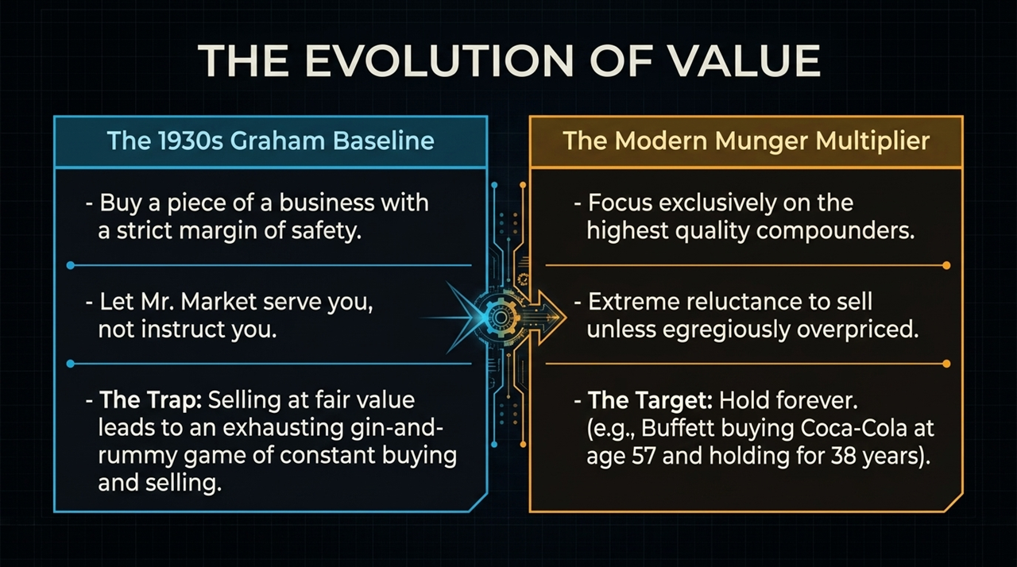
Notes:
Moving to The Evolution of Value, we contrast the classical Ben Graham baseline with the modern Munger multiplier.
The 1930s Graham Baseline: Benjamin Graham’s rules were born out of the extreme economic dislocation of the 1930s—a period of 25% unemployment. Graham taught us three irreplaceable core principles:
You are buying a piece of a business, not a ticker symbol.
Mr. Market is there to serve you, not instruct or advise you.
Always insist on a strict margin of safety.
The Trap: However, over-indexing on Graham leads to a trap—buying a stock at 40 cents, selling it at fair value (90 cents), and repeating. This becomes an exhausting "gin-and-rummy" game of constant buying, selling, paying taxes, and searching for the next fair-value target.
The Modern Munger Multiplier: Charlie Munger tilted Buffett away from "cigar butts" toward paying fair prices for elite compounders. The target is extreme reluctance to sell unless the stock becomes egregiously overpriced. The risk of holding a great business somewhat above its intrinsic value is far lower than constantly jumping in and out of stocks.
Consider Warren Buffett: his first "buy-and-hold-forever" public equity trade was Coca-Cola in 1988, bought when he was around 57 or 58 years old, and held for nearly 40 years. You don't need to wait until age 58 to adopt this rule!

Slide 4
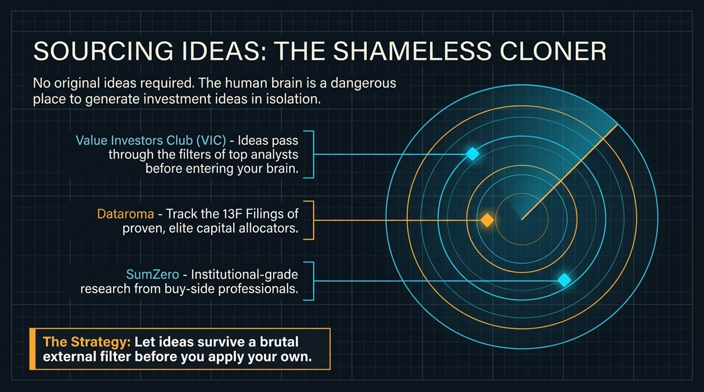
Notes:
One of the biggest mistakes fund managers make is "cutting the flowers and watering the weeds."
When Pabrai analyzes investment managers who have been running capital for decades, he looks for a specific signal: their top 2 or 3 positions should make up 70% to 80% of their total portfolio.
Yet, almost no managers have portfolios structured this way. Why? Because as soon as a great position doubles or triples (a "flower"), they trim or sell it due to false diversification concerns or tax harvesting. Worse, they take that capital and buy more of their underperforming, low-quality ideas ("watering the weeds").
Great businesses are exceedingly rare. When you are lucky enough to own a true high-return compounder, hold onto it. Water the flowers and pull the weeds.

Slide 5

Notes:
Warren Buffett famously suggested that your investment lifetime performance would dramatically improve if you were given a punch card with only 20 punches.
Every time you make a new investment, you punch the card. Once 20 punches are used, you can never make another investment for the rest of your life. Over an 80-year horizon, that equals making one investment every 3 to 5 years.
This constraint enforces the concept that Fast is Slow, and Slow is Fast. Slowing down forces extreme selectivity and rigorous due diligence. You stop chasing mediocre ideas and reserve capital only for rare, undeniable opportunities.

Slide 6

Notes:
As Warren Buffett says, the absolute size of your circle of competence is not what matters; what matters is staying firmly at its epicenter.
To illustrate this, consider John Arriga, a close friend of Charlie Munger. Arriga had an extremely tiny circle of competence: he only bought real estate within a 1-mile radius of the Stanford University campus.
He never ventured beyond that single mile. He knew the history of every building, who built it, what the rents were, and every past transaction. He kept his debt extremely low, waited patiently for downturns when distressed sellers panicked, bought properties cheaply, and held them forever. Starting with nothing, Arriga became a multi-billionaire purely by operating exclusively at the epicenter of a tiny circle.
You don't need to know everything about every market. If you know one narrow niche better than anyone else, you can achieve extraordinary wealth.

Slide 7

Notes:
Public markets are governed by extreme power laws.
Academic studies of U.S. equity markets over the past 90 years reveal that just 4% of publicly traded companies generated all net wealth creation/market returns above Treasury bills. The remaining 96% of public stocks collectively generated zero net excess return. This explains why index funds perform so well—they automatically capture and hold that critical 4%.
This aligns with Buffett’s admission that across 60 years and hundreds of hires and investments at Berkshire Hathaway, about 12 key decisions created virtually all of Berkshire's value. That’s approximately a 3% to 4% hit rate!
What is the key takeaway? Most public equities are poor long-term investments. When you are fortunate enough to buy into one of the 4% elite businesses, selling it too early is catastrophic to long-term returns.

Slide 8
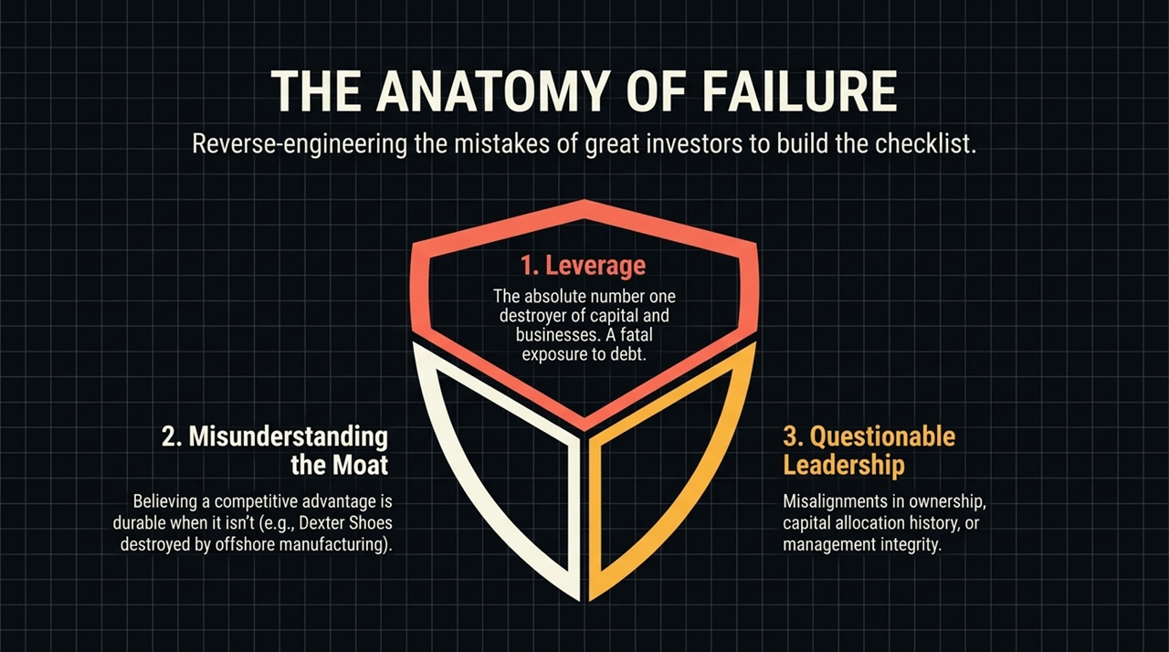
Notes:
Mohnish Pabrai openly calls himself "The Shameless Cloner."
Trying to generate original investment ideas entirely on your own is not only unnecessary, it is actually dangerous. There are no extra points for originality in capital allocation.
Instead, leverage the best free open-source investment research available:
Value Investors Club (VIC): High-quality write-ups screened by rigorous membership requirements.
Dataroma: Tracks 13F filings of elite super-investors every quarter.
SumZero: Institutional-grade investment research repository.
Cloning acts as a powerful first-stage filter. When an idea has passed through a proven investor’s mind, you can take that recycled insight, apply your own rigorous filter, and save hundreds of hours.

Slide 9
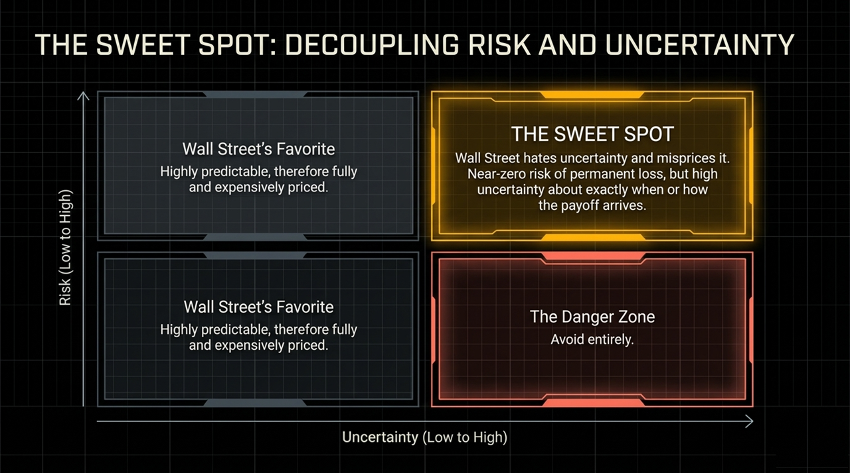
Notes:
Charlie Munger and Warren Buffett have noted that the U.S. market conditions of the 1960s, 70s, and early 80s—where extreme price-to-value disparities were common—no longer exist in the U.S. today due to fierce competition and institutional coverage.
However, history rhymes across geographical borders. While U.S. markets may be efficient, international markets frequently experience severe dislocations identical to past U.S. cycles.
For instance, Pabrai points to the Turkish stock market. In recent years, high inflation and political volatility created valuation disconnects in Turkey similar to the U.S. in the mid-1970s. He found blue-chip companies trading at $P/E$ multiples of $1.0$ or even $0.1$—where a bank's market cap equaled just one month of earnings. If an opportunity set dries up in your home market, search globally for markets rhyming with past historical eras.

Slide 10
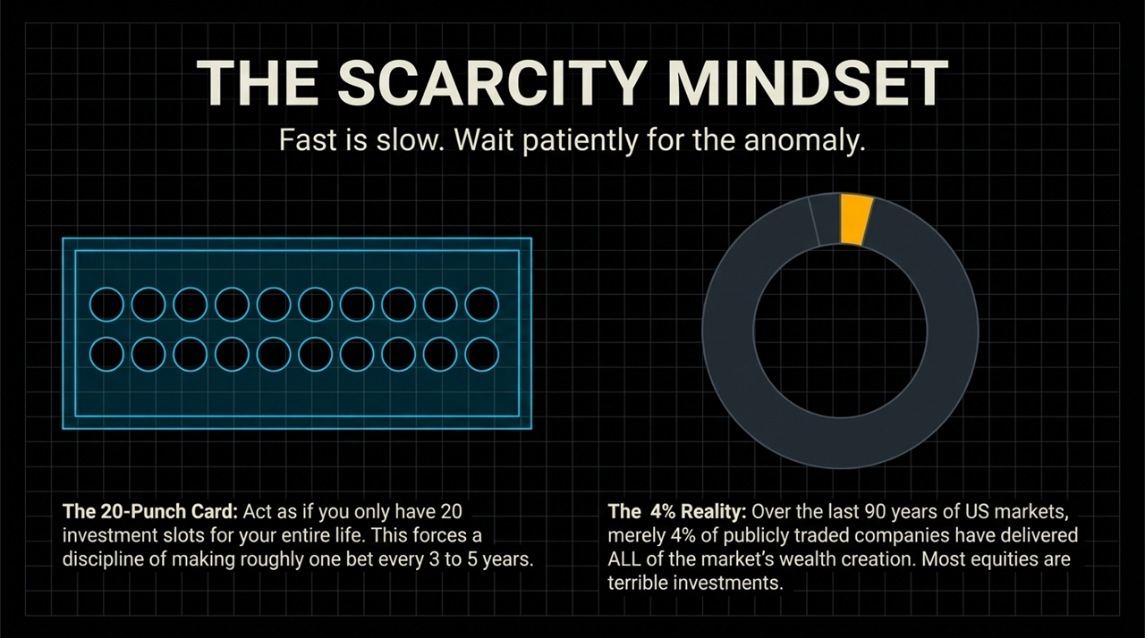
Notes:
Model 11 is simple: If you cannot explain your investment thesis to a 10-year-old child in 4 to 5 sentences, it is a useless investment. Pass immediately.
A 10-year-old won't understand complex DCF models, adjusted EBITDA, or intricate multi-tab Excel spreadsheets. The core driver of a great business must be simple and qualitative: "They make a product for $10, sell it for $30, nobody else can make it, and everyone needs it every year."
If a thesis requires elaborate financial engineering or complex mental gymnastics, you are likely compensating for a lack of genuine understanding or a weak underlying business.

Slide 11

Notes:
During the 2008–2009 Global Financial Crisis, Pabrai’s fund dropped roughly 67%—declining from $600 million to $200 million due to asset devaluation.
When you are at the bottom of a deep well, you need a rope to climb out psychologically. Pabrai recalled a story from his childhood when his father's business went bankrupt. An astrologer visited weekly to promise bright future prospects. When young Mohnish called it nonsense, his father explained: "I am at the bottom of a deep well. I need a rope to get out. His positive vision gives me the hope and energy to keep going."
In 2009, Pabrai created his own "rope": he built an Excel sheet valuing his portfolio companies at what he knew they were intrinsically worth, rather than their distressed panic market prices. Looking at intrinsic value every morning maintained his psychological fortitude, preventing him from panic-selling at the bottom.

Slide 12
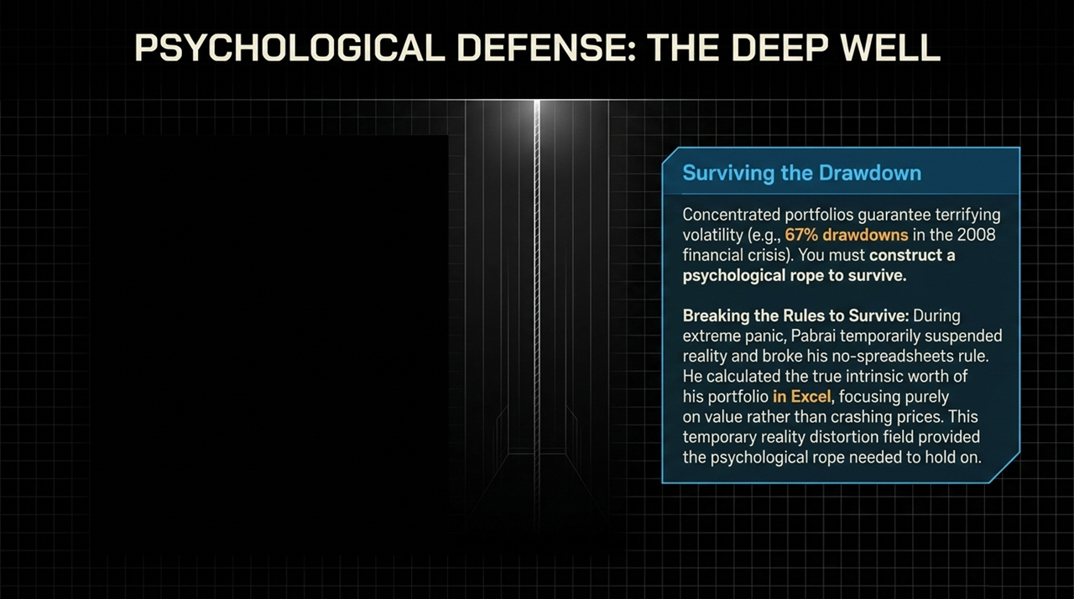
Notes:
Consider the legendary Nomad Investment Partnership run by Nick Sleep and Zakaria Zakaria.
When UK regulators pressured them to diversify their $2.6 billion portfolio, they chose to return all capital to investors. Nick Sleep advised his clients to take their returned capital and split it into three equal parts: 1/3 Amazon, 1/3 Costco, and 1/3 Berkshire Hathaway, and hold them without paying any management fees.
Sleep's philosophy was inspired by Zen and the Art of Motorcycle Maintenance—pursuing unyielding Quality in business models, management integrity, and customer value.
A key lesson here is Escape Velocity. Once your portfolio achieves financial escape velocity, high concentration in your winning compounder ceases to be a risk. When Amazon grew to 80% of Sleep's portfolio, trimming it to buy lesser companies (like ASOS) was actually a mistake. Let your best compounders run!

Slide 13

Notes:
Except when building a "psychological rope" in a crisis, thou shalt not rely on Excel spreadsheets for investment decisions.
If an investment requires high-precision financial modeling, complex discount rates, or 50 macro variables to show an attractive return, it lacks a true margin of safety.
The best investments can be calculated mentally in seconds. If you can't calculate the returns in your head on the back of a napkin, pass. Precision is an illusion in an uncertain world; rough clarity beats precise error every time.

Slide 14

Notes:
To eliminate human error and confirmation bias, adopt a Pre-Investment Checklist. Pabrai’s checklist expanded over 15 years from 70 questions to over 213 questions.
The checklist was constructed by studying historical investing mistakes made by legendary investors (e.g., Berkshire’s failed investment in Dexter Shoes due to low-cost foreign competition).
Categorizing investment failures reveals that losses overwhelmingly stem from three primary failure modes:
Financial Leverage: Excess debt destroying flexibility during downturns.
Moat Misunderstanding: Overestimating the durability of a competitive advantage.
Management/Governance Issues: Questionable leadership, misaligned ownership, or union/regulatory risks.
Run every investment through a failure checklist before pulling the trigger.

Slide 15

Notes:
Exceptional capital allocation demands exhaustive intellectual thoroughness.
"Read the Footnotes": Named after Seth Klarman’s thoroughbred racehorse, this model highlights where truth is buried. Management teams hide risks, off-balance-sheet liabilities, and dilutive compensation in footnote fine print.
"Turn Every Page": Inspired by the Netflix documentary on biographer Robert Caro, who spent decades turning every single page of historical archives.
Look at Warren Buffett’s lifetime habits:
At age 12, collecting discarded race tickets at Ak-Sar-Ben track looking for winning tickets dropped by mistake.
At age 24, turning every single page of the dense Moody’s Manuals.
In his 80s, turning every page of the Japan Company Handbook, leading to a $5 billion leveraged investment in 5 Japanese trading firms that now yields massive cash dividends.
Diligence is about enjoying the hunt for needles in haystacks.

Slide 16

Notes:
To conclude our first section, we cover two crucial behavioral guardrails:
1. The Sounding Board: Never trust an idea that exists purely inside your own isolated head. The human brain is a dangerous place for confirmation bias. Even Charlie Munger emphasized having sounding boards (like Buffett or Li Lu) to stress-test ideas. Run your cloned ideas through a trusted peer before deploying capital.
2. The Mistress Illusion: In investing, the stock you don't own always looks hotter than the stock you do own.
Novel, shiny, foreign opportunities appear attractive because you haven't yet uncovered their flaws. Meanwhile, your existing portfolio holdings feel boring. Do not abandon high-quality businesses you thoroughly understand to chase shiny, unfamiliar distractions. Stay focused!

